Slide 1


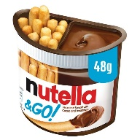
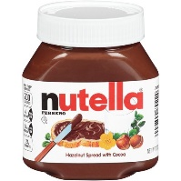
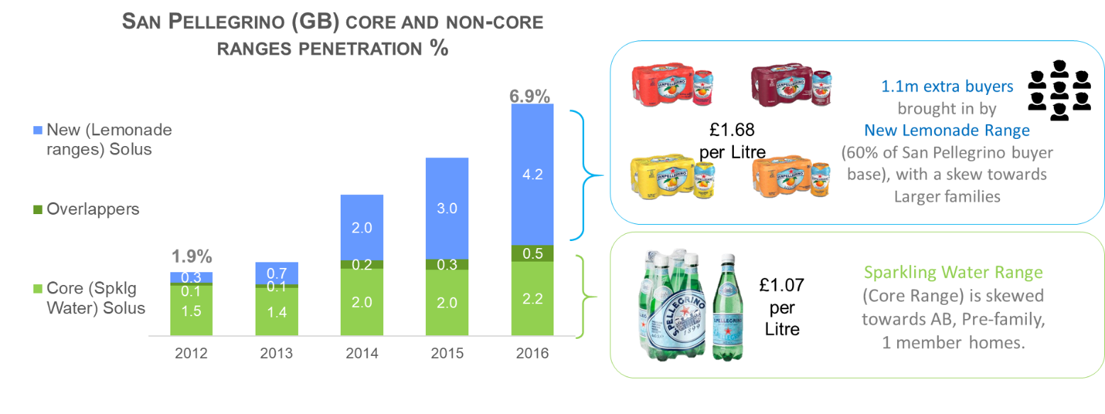
DEVELOP
Case studies How to learn from successful brands in similar situations
Re-define the category by moving the brand into new consumption occasions
DEVELOP
Innovation: Develop the category, consider adjacent categories
Nutella & Go
Launch into the more frequently purchased snacks category
Nutella Spreads
Largest brand within the chocolate spreads category, and hence strong brand awareness and
Nutella has innovated into the adjacent snacking category, which offers a much higher frequency of purchase opportunity.
Assortment: Cover all category needs, incremental innovation
San Pelligrino has developed its brand into new consumption occasions by entering soft drinks. This delivers a higher premium and a more frequency category.

Slide 2
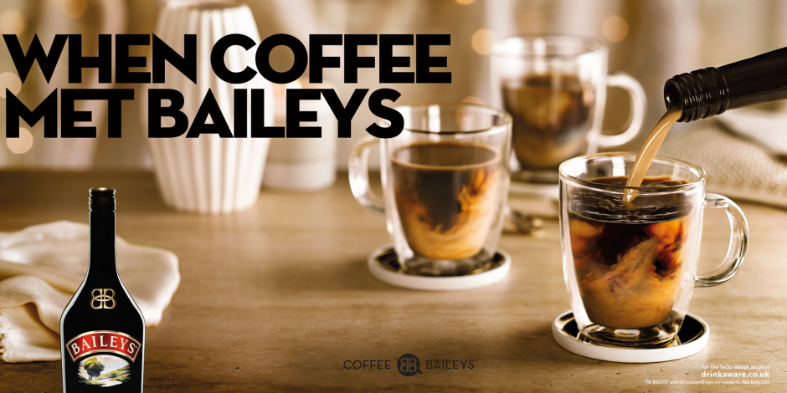
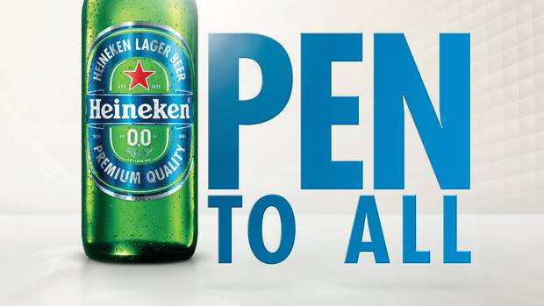
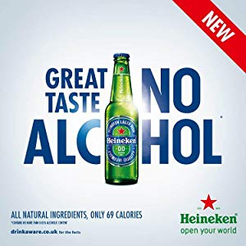
DEVELOP
Case studies How to learn from successful brands in similar situations
Re-define the category by moving the brand into new consumption occasions
DEVELOP
Attitudes: Be more relevant, more often
Baileys will focus on associating itself with coffee to take advantage of the 18.5 billion cups of coffee that are consumed each year across Great Britain, a strategy that has already proved fruitful in North America.
Our strategy is about getting our indulgent product out of the cupboard and into more glasses in many more occasions.
Laura Pearce, Baileys
Advertising: Target category rejecters
Heineken is looking to grow the alcohol free category by overcoming three barriers
Overcome taste and legacy issues
Wider visibility
Educate consumers to drive trial
Notes:
https://youtu.be/XRgqiPO1uuE

